Slide 1
Configuring Server to communicate with CET meters (Ethernet)
CET Inc.
www.cet-global.com

Slide 2
Contents
Configuring the Meter Settings
1. Connect to meter
2. View server network information
3. Configure meter communication settings
Verifying the Communication
Ping meter IP
Troubleshooting

Slide 3
Configuring the Meter Settings

Slide 4
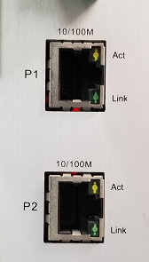
1. Connect to meter
·
Select a port to connect
Make sure the Ethernet cable plug in the right port corresponding to meter settings.
Picture.1 Some meters have 2 port available

Slide 5
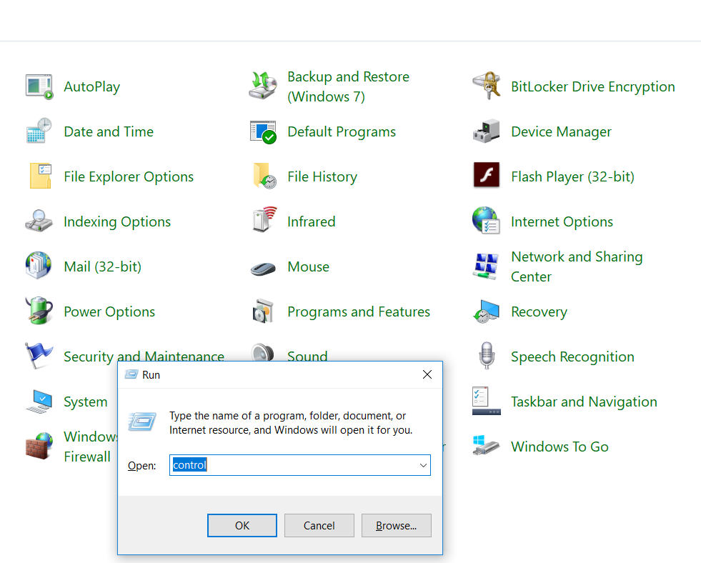
2. View server network information
1)
Open network and sharing center
1
WinKey + R on your keyboard. Or you could open the start menu and type Run.
2
Enter control in the Run Command box followed by the Return key.
3
3
Now Control Panel come out, click to enter Network and Sharing Center.
1
2

Slide 6
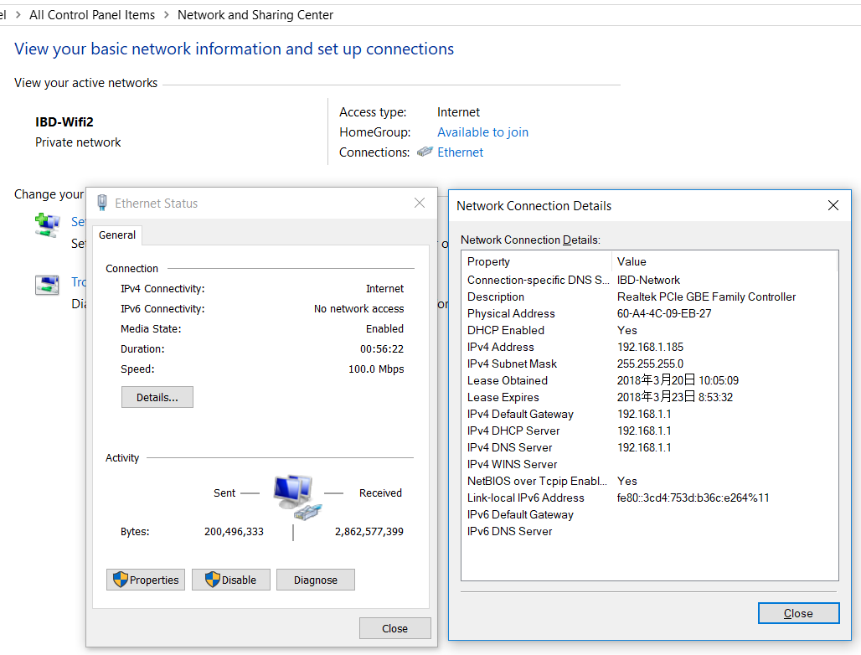
2. View server network information
2)
Check the network information
1
Click Ethernet of the View your active networks list.
1
2
Click Details… under General tab.
3
Check the IPV4 Default Gateway on Network Connection Details to assign an IP for meter.
2
For example,
Here the IPV4 Default Gateway is 192.168.1.1
You can assign an IP 192.168.1.145 for the meter
3

Slide 7
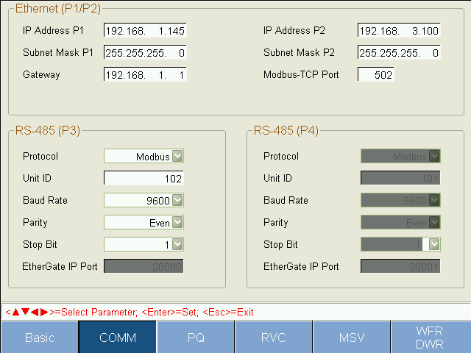
3. Configure meter communication settings
1)
Open communication settings in front panel HMI
3
1
Enter Setup on Home page of HMI
2
Press Tab button on meter front panel and turn to COMM setting page
1
3
Press Enter button and fill in the IP Address (P1/P2) assigned to the meter and IPV4 Default Gateway
4
Press Enter button again to confirm the modification.
2

Slide 8
Verifying the Communication

Slide 9
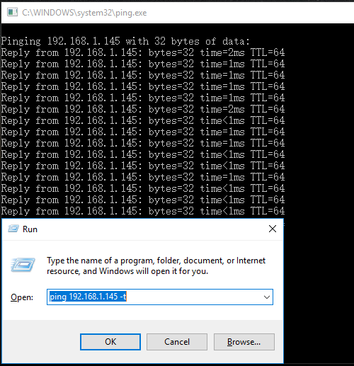
1. Ping meter IP
·
Open communication settings in front panel HMI
3
1
WinKey + R on your keyboard. Or you could open the start menu and type Run.
2
Enter ping IP -t (Like ping 192.168.1.145 t) in the Run Command box followed by the Return key.
3
You can see the reply message on a command window if communicating with meter successfully.
1
2

Slide 10
2. Troubleshooting
·
No reply when ping meter IP
1
Check is there any problem with the Ethernet cable.
2
Check whether the meter gateway is the same with the server’s

Slide 11
Thank You
Nathan
20180322

